Slide 1
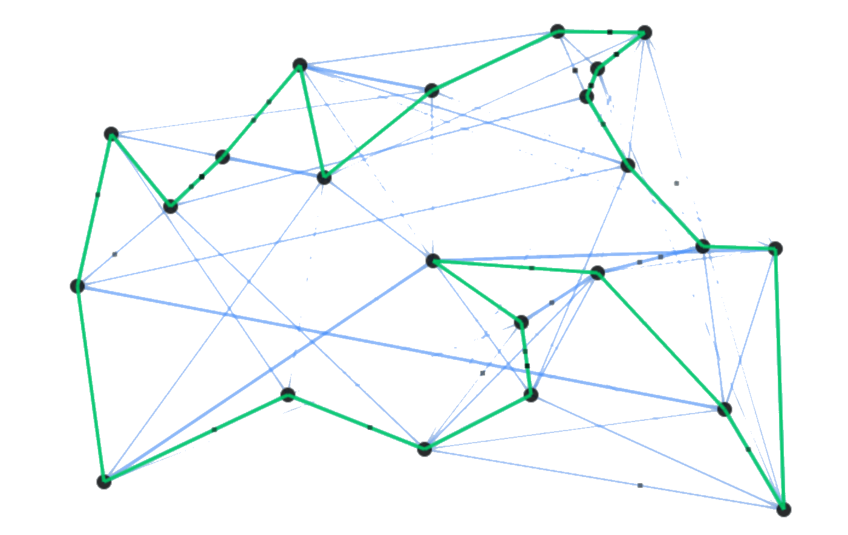
Ant Colony Optimization
Chakravarthy Sir, Vinod Babu Sir
N151280 - A. Ravi Teja
N150712 - A. Bhuvana Priya
N150902 - G.Divya
N150574 - P. Aswini

Slide 2
Contents :
1. Biological Inspiration
2. The Optimization Technique
3. MatLab Results
4. Applications
5. References

Slide 3
1. Biological Inspiration
Swarm Intelligence
It is a artificial Intelligence based on the collective behaviour of decentralized,
self-organized systems
BMO
ACO
PSO

Slide 4
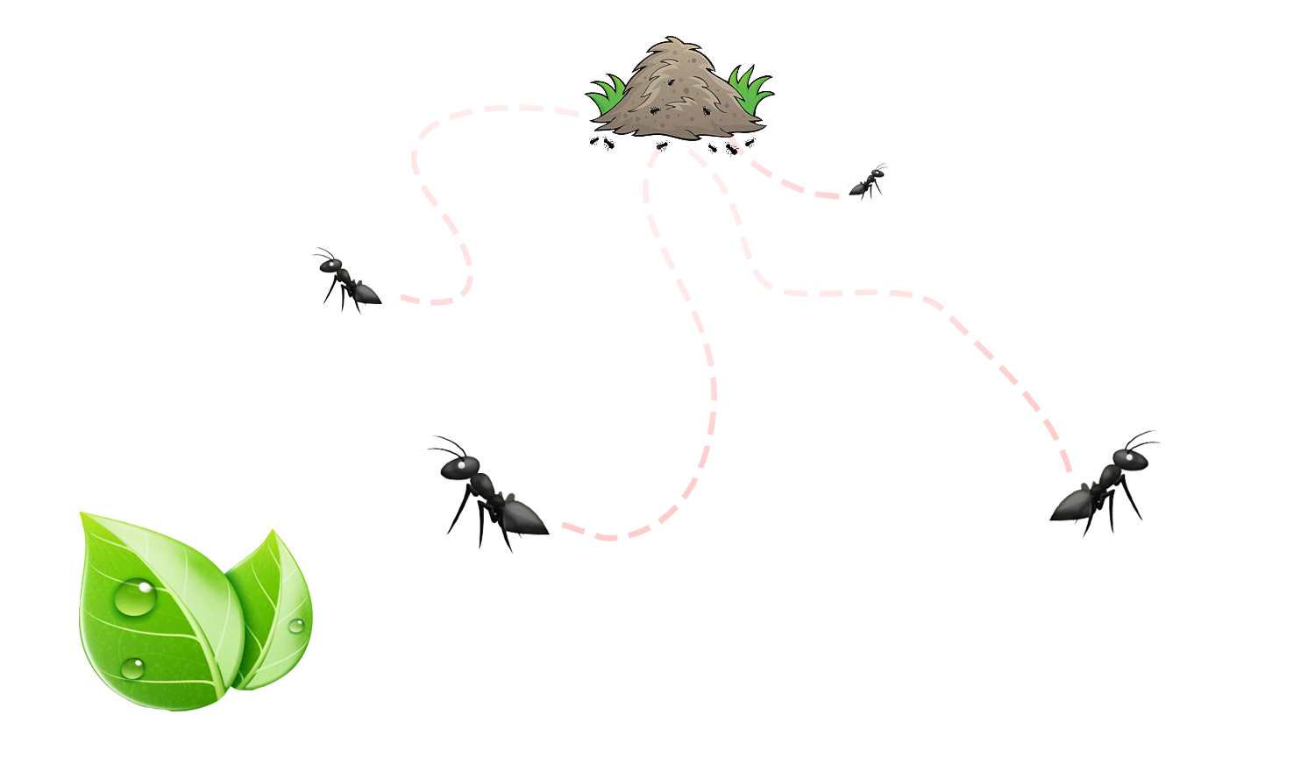
1.Biological Inspiration :
Natural Behaviour of Ants
- Essentially Blind, Deaf and Dumb
- They deposite “Pheromone”

Slide 5
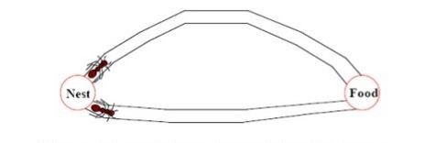
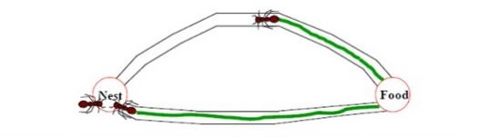
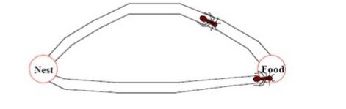
1.Biological Inspiration :
Shortest Path

Slide 6
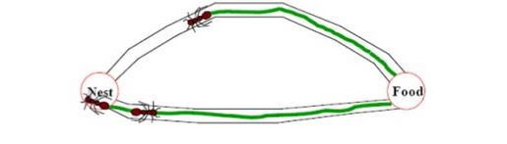
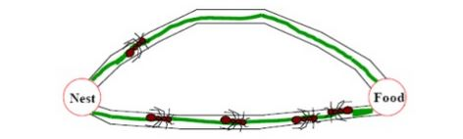
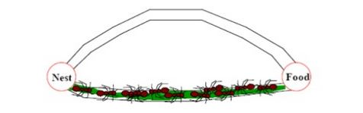
1.Biological Inspiration :
Shortest Path

Slide 7
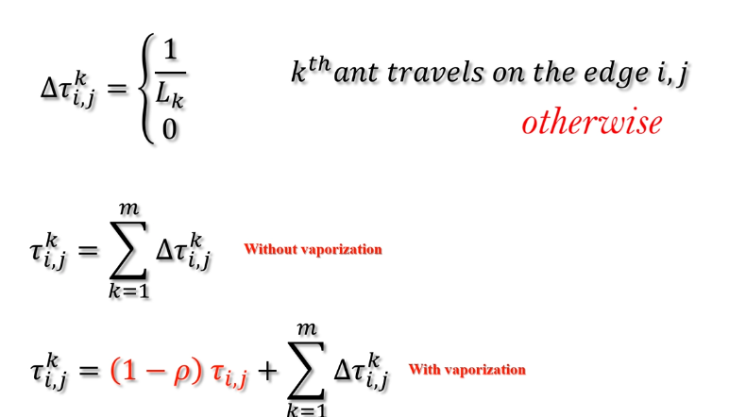
2. The Optimization Technique

Slide 8
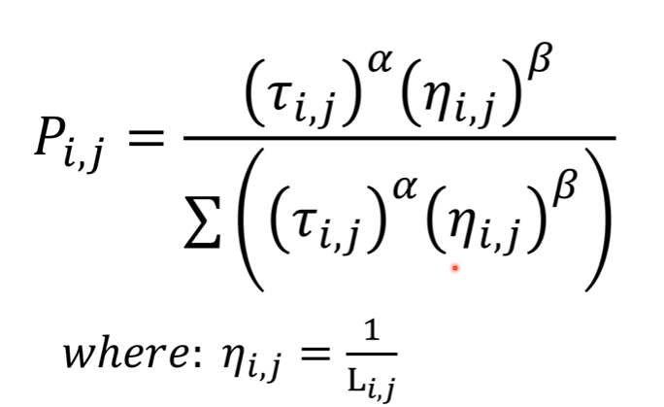
2. The Optimization Technique
For Calculating Probabilities

Slide 9
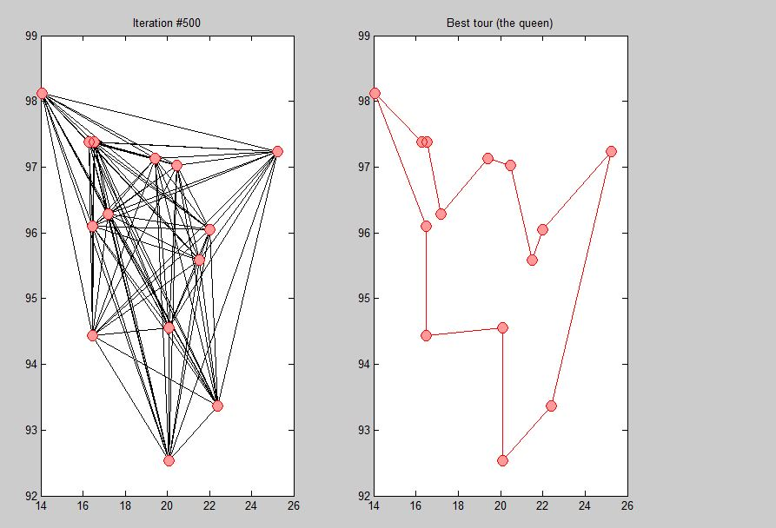
MatLab Results :

Slide 10
Applications :
Traveling Salesman Problem
Quadratic Assignment Problem
Network Model Problem
Vehical Routing
Graph Coloring

Slide 11
References :
Ant Colony Optimization , Marco Dorigo, Mauro Birattari, and Thomas St ü tzle
Université Libre de Bruxelles, BELGIUM
2. M. Dorigo, V. Maniezzo, and A. Colorni, “Ant System: Optimization by a colony of
cooperating agents,” IEEE Transactions on Systems, Man, and Cybernetics—Part B, vol. 26, no. 1,
pp. 29–41, 1996.
3.https://www.slideshare.net/MeenakshiDevi/ant-colony-optimization-11696728

Slide 12
Thank You

